Slide 1
doForms and Insurance
Use Cases and Examples
Erin Owens and Laura Teller
July, 2015

Slide 2
Overview: doForms and Insurance
doForms has many different potential use cases for the insurance industry, for example:
Property & Casual; Automotive
  Claims adjustment and damage assessment
  Repair estimates from vendors
  Property risk assessment
  Customer applications
  Quotes
  Sales activity reporting
Life Insurance (HIPAA-compliant version)
  Applicant health examinations
  Customer applications
  Quotes
  Sales activity reporting
Anywhere there’s inefficient and expensive paper… doForms can help!

Slide 3
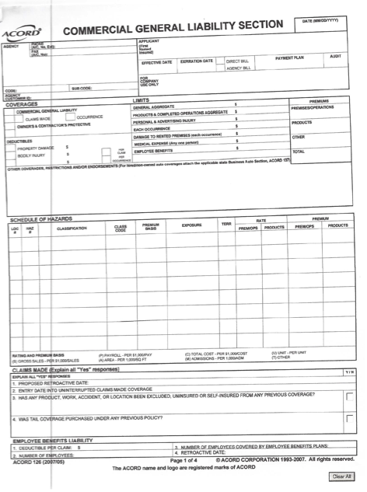
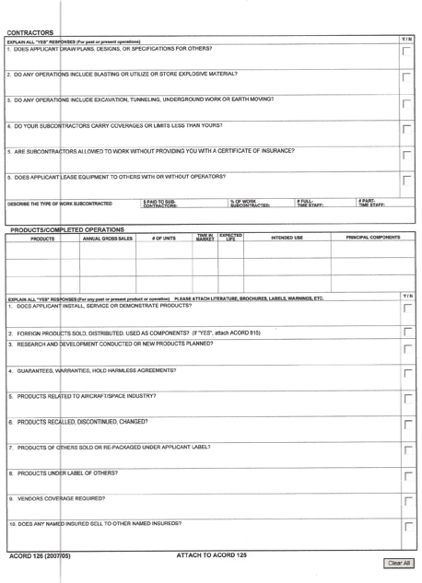
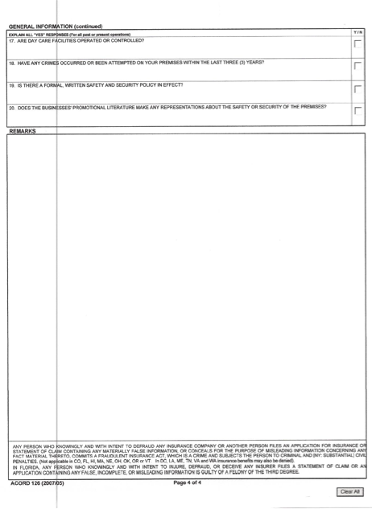
Example: this paper form is complicated and hard to fill out… and then must be manually entered into systems

Slide 4
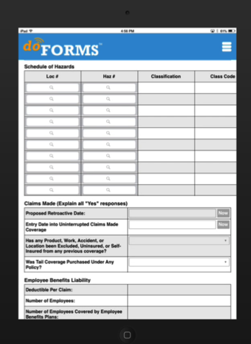
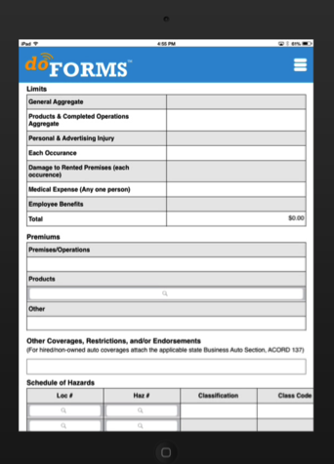
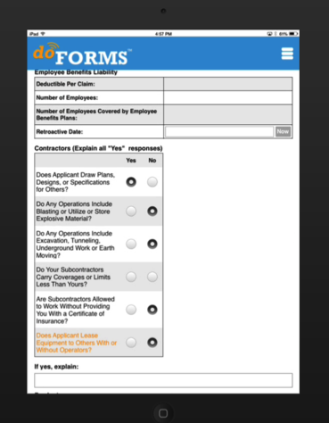

We use all the power of today’s mobile devices to turn paper forms into this…
Auto- calculation
Look-up table
Automatic date stamp
Photo and write-on photo
“Choose One” Buttons
Contextual logic (field appears only after specified answers)
GPS and mapping
Dropdown menu
Voice-to-text

Slide 5


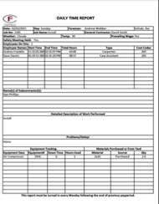


Then we automatically send this information back to the office – as well as directly email PDF or Excel documents to customers and company personnel in a “familiar” format

Slide 6
Selected Use Cases

Slide 7
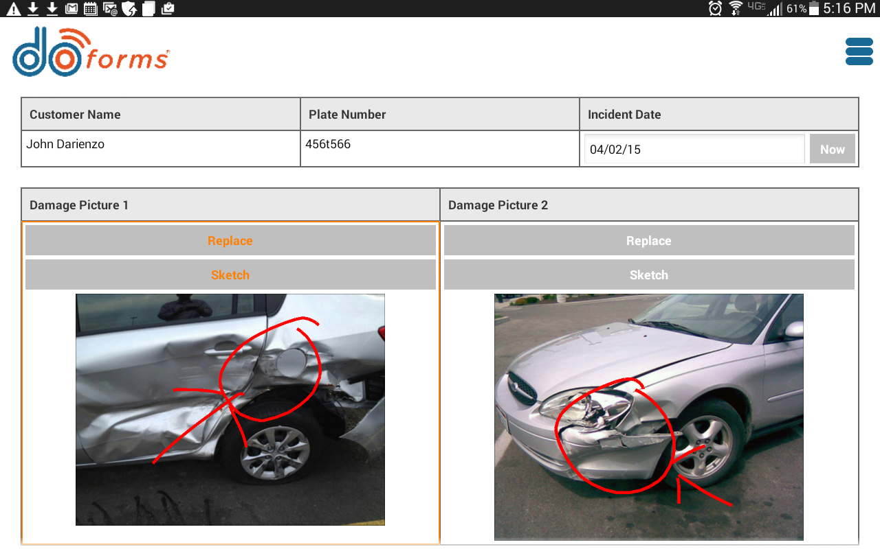
Use Case: Claims Adjustment/Damage Assessment
Benefits:
Ability to dispatch form with pre-filled information (customer name, address, etc.)
Faster form completion
Immediate integration of documentation and signatures into a single form
Immediate submission to customers, vendors, supervisors, and back office
(PDF or Excel docs via email, plus immediate upload into doForms Web dashboard)
Broader, more accurate documentation
  Unlimited photos
  Unalterable date and time stamp

Slide 8
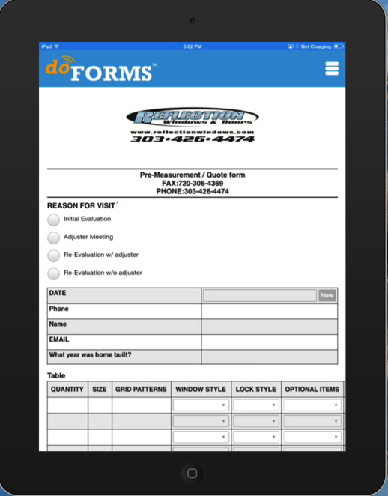
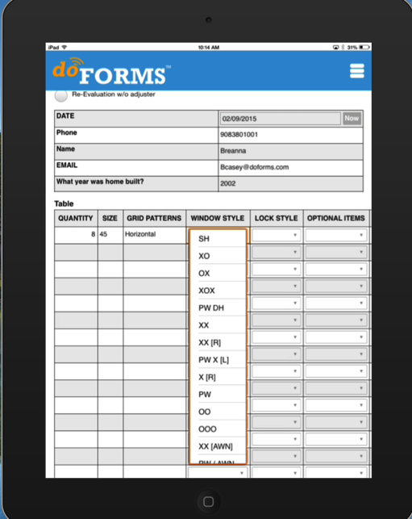
Use Case: Repairer Quotes
Situation/Benefits:
Large window company often asked by insurance companies to appraise damage, estimate repair costs and propose approaches/materials
doForms allows the company to rapidly create and submit details required by the insurer, including time stamps, location, photos, detailed explanation of damage, equipment and window specifications, cost estimates, owner sign-off, insurer sign-off, and more… in a single form
Reduces back office burden on insurers while significantly improving documentation, expense control, and speed of repairs

Slide 9
Use Case: Property Risk Assessment
Benefits:
Use of drop-down menus, radio buttons, autofill, ability to link to databases, etc. reduces input errors and time to fill out forms
Documentation significantly improved via photos, GPS and time stamps, signature capture, use of the “required field” feature, etc.
Repetitive information capture eliminated
Integration of photos, time and GPS stamps, and signature directly into the form reduces aggregation headaches in the field and back-office burden

Slide 10
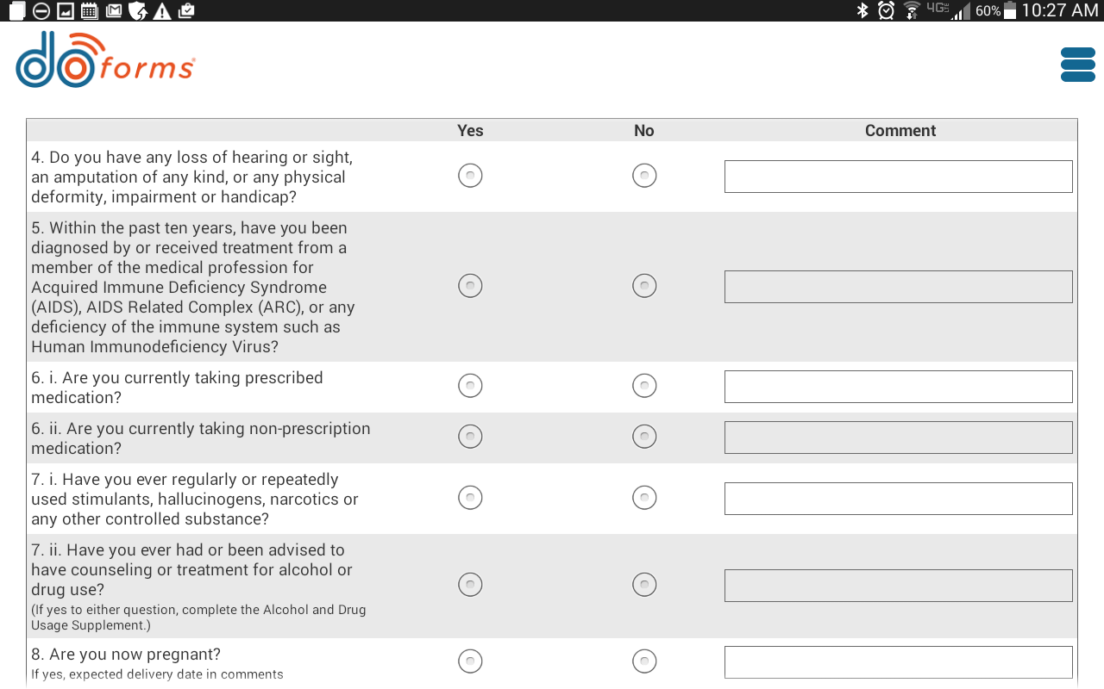
Use Case: Life Insurance Applicant Examinations
A company that performs in-home examinations of life insurance applicants to one of the largest U.S. life insurance companies uses doForms throughout its operations, from scheduling and dispatching all the way to capturing applicant data during the examination

Slide 11



Use case: in-home examinations for life insurance (continued)
A complete, integrated workflow via doForms Sync & Save integration with Salesforce
7. Form information is sent back to customer’s web portal, PDF is sent to insurance company, and information is captured in Salesforce and also generates a bill to insurance company
2. doForms pulls assignments via its Sync & Save integration capability
Sync & Save
integration
5. doForms dispatches pre-filled form (address, directions) to nurse
6. Nurse completes examination using a doForm form on tablet
1. The company’s Salesforce records capture assignments from the insurance company
3. doForms alerts nurses of a potential job in their area via SMS.
4. If nurse accepts, doForms captures it and sends back to company

