Slide 1
doForms in the Government Vertical
Bringing efficiencies and cost savings to state, local, and federal governments
doForms, Inc.
14 Commerce Drive, Suite 100
Cranford, NJ 07016
908-505-9020
www.doforms.com
Contact: Laura Teller, SVP, Strategic Partnerships
lteller@doforms.com
908-505-9020 X 309; 609-613-3360 (M)

Slide 2
Doforms and Government: Overview
200+ state, local, federal government, NGOs, and public utility use cases globally
Horizontal use cases throughout many different governmental functions
Facility, Utility, Public Works Field Inspection
Repairs and Maintenance Documentation and Management
Facilities Documentation
Data Gathering & In-Field Surveys
Work Force and Work Flow Management
Health Services
Police, Fire, Emergency Response
WSCA (ValuePoint) registration pending
doForms has been awarded GSA contract number GS-35F-415CA

Slide 3
Use Cases

Slide 4
Canton, GA: Workflow and Jobs Management
Canton, GA uses doForms to create mobile applications that allow their departments to manage work orders throughout the city.
“By using doForms, we are able to create mobile applications that allow our departments to manage work orders throughout the city. It provides us with a more efficient way of collecting data and distributing our work force. By using doForms, we are able to save time and money.”
--Camille Wehs, Director of IT/GIS, City of Canton, GA

Slide 5
Large Public School System: Program Compliance Monitoring
One of the largest public schools systems in the U.S. uses doForms to monitor special education classes and ensure:
Compliance with preferred lesson plans and pedagogy
Classroom safety and cleanliness
Student safety and monitoring practices

Slide 6
Military Base Management & Inspection: Water Supply Maintenance and Environmental Compliance
A subcontractor to the U.S. military uses doForms to inspect utilities and ensure water use and environmental compliance for Ft. Benning, GA.
The subcontractor reports that it has cut the time it takes to complete and document inspections by over 75%: “What used to take us 6 days now takes 1.”

Slide 7
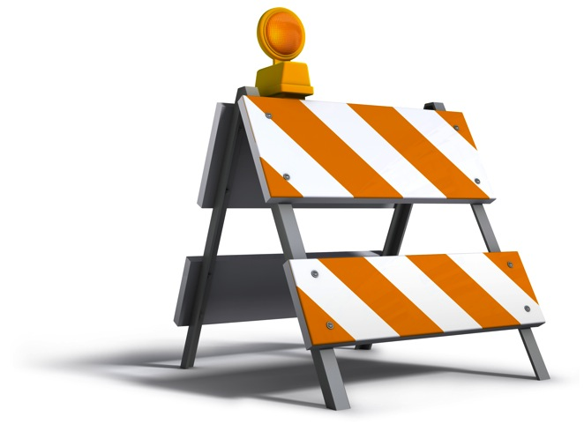
Utilities Maintenance: Gas Transmission Facilities Inspection
One of the largest West Coast utilities, Pacific Gas & Electric, employs doForms in its gas transmission operations for maintenance and inspection services.
“We can save money and training by having people who work on the collected data for analysis rather than doing heavy lifting data work in the field.”

Slide 8
National Center for Biotechnology Information: Global Field Data Collection
doForms is used as part of of an international, global effort to combat the HIV epidemic. Scientists are using doForms to collect data, including survey responses, barcodes for biological samples, and GPS coordinates for study sites
“This easy-to-use platform simplifies and facilitates the design and creation of data collection instruments, as well as the collection, management, and analysis of data… immensely improving the quality of our work, while saving us both time and money.”-- Stephen Delgado, Senior Epidemiologist Consultant, HIV Prevention & Control, Central America Operations

Slide 9
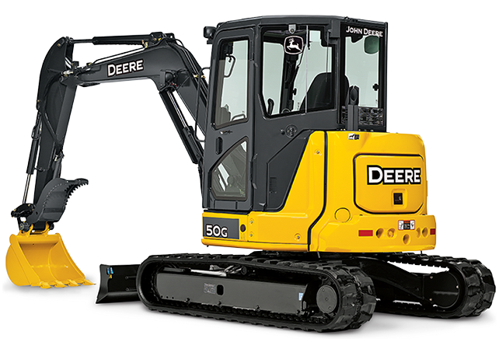
In-Depth Case Study: Improving Excavation Management, City of Brenham, Texas
Brenham, Texas is using doForms extensively in monitoring and controlling excavation and digging
Case 1: Streamlining dispatches for digging.
In Texas (and many other states), any digging to a depth greater than 16 inches requires a call to the Texas 811 Call Center, which dispatches a "ticket" to the utility company. The utility company then has 48 hours to mark the utility lines in the area of the excavation site.
Before doForms, the utilities’ line locators would be contacted by the office whenever an 811 ticket was received; the physical ticket was then placed in an outbox for pickup by the line locator. The locator would have to drive in repeatedly from the field throughout the day to pick up new tickets and drop off completed tickets.
With doForms Dispatch, the locators can stay out in the field and receive and send tickets, making them more efficient and responsive – and Brenham reduces its inefficient paper flow.

Slide 10
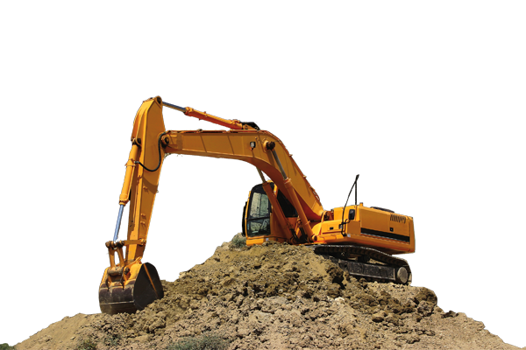
In-Depth Case Study: Improving Excavation Management, City of Brenham, Texas (continued)
Case 2: Documenting line “hits” to end disputes
All gas lines that have been hit have to be reported to the Texas Railroad Commission by the utility operator and the excavator. Each case is reviewed and fines assessed if any violations to excavation rules are discovered. Whenever there are disputes between parties or personal injuries involved, the photo evidence before and after pipe damage is critical.
Before doForms, the locators took pictures with a digital camera and then transferred the pictures to a computer. They then had to organize and label the photos to the associated ticket. This was a very time-consuming and sometimes confusing process, particularly if multiple locations were assessed in a single day. With doForms, integration of the photos into the Line Locate form has made this part much easier.

Slide 11
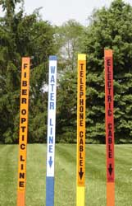
In-Depth Case Study: Improving Excavation Management, City of Brenham, Texas (continued)
Case 3: Improving compliance and streamlining reporting
With the Line Locate form in their doForms account, the locator can rapidly answer a series of questions regarding the utility markings. This follows the TX Railroad Commission rules, hepling ensure compliance
At the end of each month, Brenham can easily export the line locate data captured in doForms into an Excel worksheet and prepare a summary report for management. – saving hours of manual compilation and aggregation

Slide 12
For more information, visit www.doForms.com or call 908-505-9020

