Slide 1
Agribusiness Use Cases
July, 2015

Slide 2
doForms and Agribusiness

Slide 3
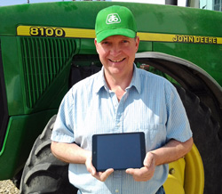
Field data collection with doForms – literally!
A family owned-and-operated farm located in Southern Michigan and Northern Indiana that grows potatoes, tomatoes and grain crops
Have 10 mobile units using doForms for remote data collection
In the field – quite literally – recording conditions such as:
types of weeds growing
tractor operating status
number of times equipment is turned on or off

Slide 4
On land and sea, doForms streamlines inspections
The world’s leading inspection, verification, testing and certification company
On land -- collects soil samples in field, bags and barcodes for analysis and for developing crop recommendations for agribusiness
On sea – SGS inspects large ships at ports around the world
doForms helps manage this field collection process, streamlining and consolidating the time/date stamping with the inspection forms

Slide 5
Getting healthy as a horse with doForms
Texas-based Equine Services, Ltd. provides wellness treatments to horses
Data collection in the barn and record keeping via doForms is essential to keep track of treatments and accelerate the healing process
doForms is used to keep a very clear and concise record of what horse is treated for what and when

Slide 6
Using doForms to help bring technology to ag
Agriculture solutions company located in Clarksdale, Mississippi, working with GPS systems and lasers to keep their farms up to an excellent standard
Record data on equipment with doForms
Use doForms barcode function to keep track of what rentals are coming in and out of their possession, as well as daily rental fees

Slide 7
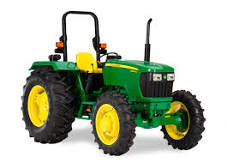
Making it easier to buy and sell farm & construction equipment
One of North America’s largest John Deere construction equipment dealers with 28 locations throughout the US
Uses doForms to:
Allow technicians to assess and document the value of used tractors before making a purchase offer for them
Allow purchasers to view Murphy’s online catalogue even if there is no signal or connectivity, and place orders.
“The time and money this application saves us is huge. Now a technician can collect data and photos at the site, send, and move on to the next machine. And the salesperson can go over the catalog with the client and place the order directly on his or her tablet.”
-- Max Miller, Vice President,
Murphy Tractor and Equipment

