Slide 1
Construction and Building Trades
July, 2015

Slide 2
doForms and Building Trades/ Residential Services

Slide 3
doForms helping bring projects in on time – profitably
doForms being used to estimate projects as well as to track progress and hours on ongoing projects
Tracking and on-time delivery vastly improved: 80% of projects being tracked by doForms are on or ahead of schedule versus <50% of other projects

Slide 4
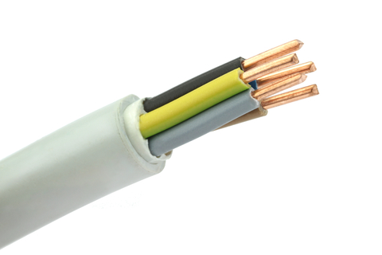
doForms enabling an electrical contractor to manage workflow and field activities
Residential and commercial contractors located in Arlington, Massachusetts
Use doForms to create work orders, as well as keep track as which technician is completing what job
The company is also using doForms Integration & Synchronization capability, which allowed them to rapidly configure data flow from forms directly into and out of their QuickBooks system using doForms pre-built connectors and simple drag-and-drop interface

Slide 5
doForms helping a growing business… grow!
Company of lawn care professionals located in Irving, Texas
Prides itself in being able to assist with whatever lawn care service their customers may need, from fixing brown spots to ant treatments
Use doForms to notate what services are being provided to which lawns in an efficient mobile fashion
Also using doForms to keep a transparent schedule for call back calls to customers

Slide 6
Use Case: Repairer Quotes
Large window company often asked by insurance companies to appraise damage, estimate repair costs and propose approaches/materials
doForms allows the company to rapidly create and submit details required by the insurer, including time stamps, location, photos, detailed explanation of damage, equipment and window specifications, cost estimates, owner sign-off, insurer sign-off, and more… in a single form
Reduces back office burden on insurers while significantly improving documentation, expense control, and speed of repairs

Slide 7
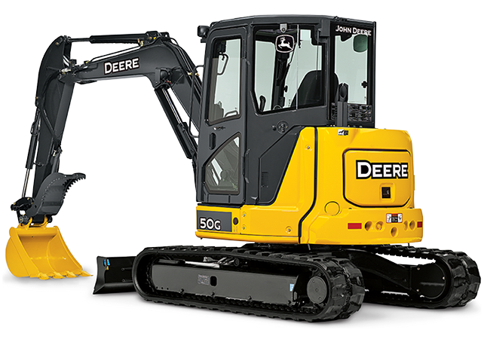
Making it easier to buy and sell construction equipment
One of North America’s largest John Deere construction equipment dealers with 28 locations throughout the US
Uses doForms to:
Allow technicians to assess and document the value of used tractors before making a purchase offer for them
Allow purchasers to view Murphy’s online catalogue even if there is no signal or connectivity, and place orders.
“The time and money this application saves us is huge. Now a technician can collect data and photos at the site, send, and move on to the next machine. And the salesperson can go over the catalog with the client and place the order directly on his or her tablet.”
-- Max Miller, Vice President,
Murphy Tractor and Equipment

