Slide 1
Construction and Building Trades
Bringing the efficiency and cost savings of mobile forms to the construction industry
doForms, Inc.
14 Commerce Drive, Suite 100
Cranford, NJ 07016
908-505-9020
www.doforms.com
Contact: Laura Teller, SVP, Strategic Partnerships
lteller@doforms.com
908-505-9020 X 309; 609-613-3360 (M)

Slide 2
doForms and Construction/Building Trades

Slide 3
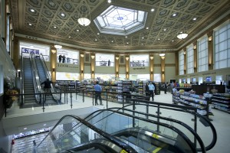
JLL uses doForms to create renovation plans and manage properties
Use Case: Facility Renovation
JLL is one of the largest real estate management companies in the world -- often charged with managing renovations on thousands of stores at once.
JLL’s forms have thousands of questions and dozens of photographs – doForms scales to handle these and easily manages photos to keep file size down
doForms consolidates all forms per store into a single custom Excel template that’s provided to the customer
First project saved one data entry FTE ($40,000 annually) and 2-4 hours/day of inspection time
Employees bringing in doForms awarded a JLL DaVinci Award for outstanding new technology discovery
JLL now building doForms into all its proposals: “here’s how we’ll track and manage the project” – and asking subcontractors to use doForms as well

Slide 4
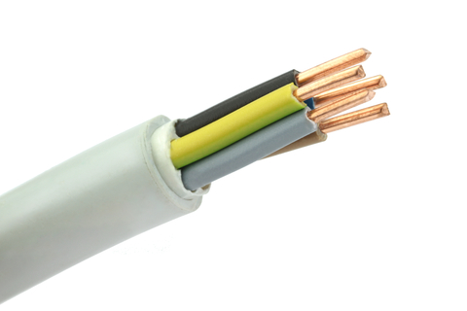
doForms enables an electrical contractor to manage workflow and field activities
Use Case: Field Workflow Management
Residential and commercial contractors located in Arlington, Massachusetts
Use doForms to create work orders, as well as keep track as which technician is completing what job
The company is also using doForms Back Office integration capability, which has allowed them to rapidly configure data flow from forms directly into and out of their QuickBooks system using pre-built connectors and a simple drag-and-drop interface

Slide 5
doForms streamlines estimates, improves documentation, speeds approvals
Use Case: Repair Quotes and Estimates
Large window company often asked by insurance companies to appraise damage, estimate repair costs and propose approaches/materials
doForms allows the company to rapidly create and submit details required by the insurer, including time stamps, location, photos, detailed explanation of damage, equipment and window specifications, cost estimates, owner sign-off, insurer sign-off, and more… in a single form
Reduces back office burden on insurers while significantly improving documentation, expense control, and speed of repairs

Slide 6
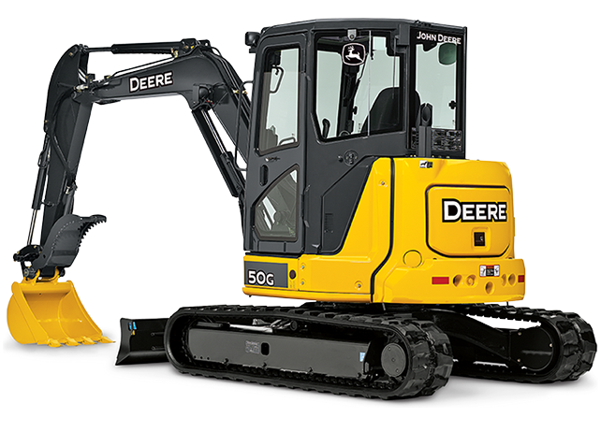
Making it easier to buy and sell construction equipment
Use Case:
Equipment Management & Sales
One of North America’s largest John Deere construction equipment dealers with 28 locations throughout the US
Uses doForms to:
Allow technicians to assess and document the value of used tractors before making a purchase offer for them
Allow purchasers to view Murphy’s online catalogue even if there is no signal or connectivity, and place orders.
“The time and money this application saves us is huge. Now a technician can collect data and photos at the site, send, and move on to the next machine. And the salesperson can go over the catalog with the client and place the order directly on his or her tablet.”
-- Max Miller, Vice President,
Murphy Tractor and Equipment

Slide 7
Keeping Better Track of Equipment and Improving Servicing While Saving Money
Use Case:
Temporary Site Services
Provide port-a-potty services and other temporary site services to construction industry
Struggling with unserviced restrooms, paper-form-based truck maintenance records, keeping track of inventory and knowing when it’s available to be sent out to the field
doForms now vastly improving performance in all these areas
Saving company $70K/year, 3,000 man-hours
“We were facing many challenges that were directly affecting our customer service, or at least the perception of our customer service. Certain applications, such as Dispatch, have immensely improved our real-time communication between our drivers and the back office well as between our company and our clients.”
Sharon Manley, Chief Financial Officer,
Andy Gump Temporary Site Services, Santa Clarita, CA,

Slide 8
For more information, visit www.doForms.com or call 908-505-9020

