Slide 1
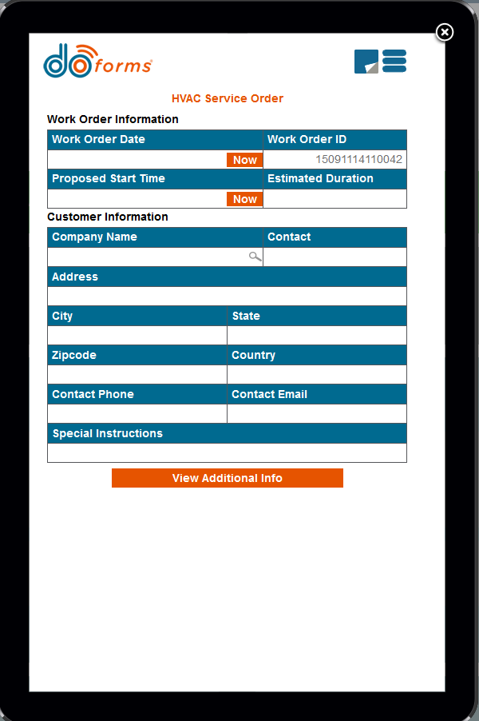
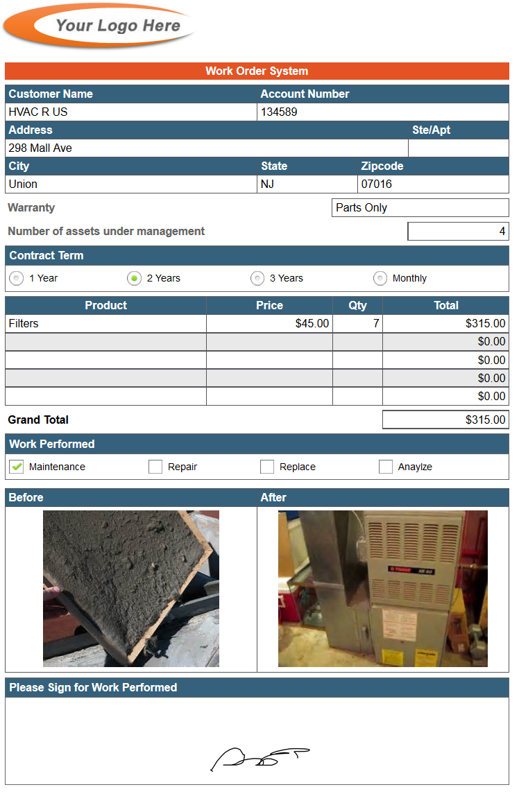
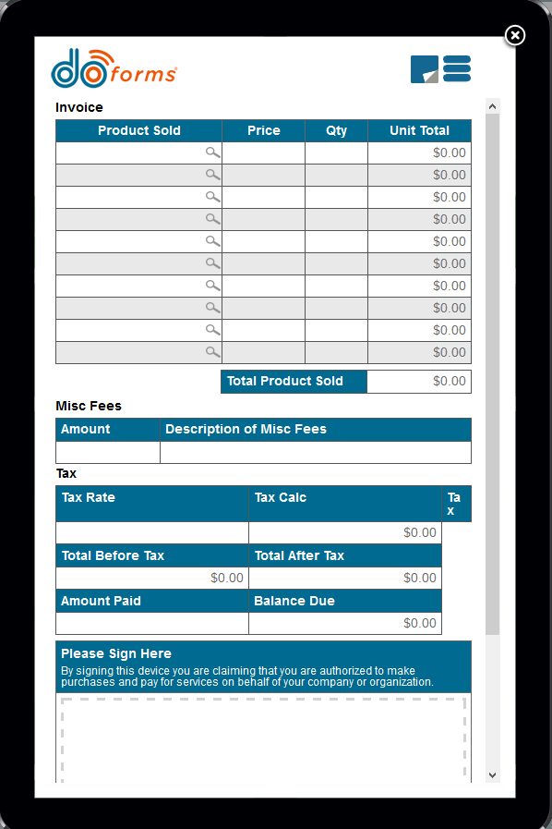
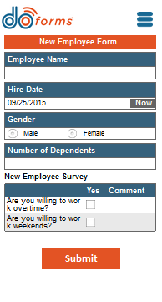
doForms
The power, productivity, and cost savings of mobile forms is now at hand

Slide 2
Paper forms eat at your profits and productivity
Example:
5 employees in the field
~2,200 hours/year
~ $60,000 in hard costs and labor
5 one-page forms/employee/day
10 minutes/form in field
10 minutes/form for data entry
10 trips to pick up/drop off forms each month
The average cost of a paper form is $7.40!¹
1. .AIIM – The Global Community of Information Professionals: The Paper Free Office – Dream or Reality? (2012)

Slide 3
doForms gets you out from under paper
doFORMS AVERAGE IMPACT* ON MOBILE OPERATIONS
50% shorter form completion and manual data entry time
For prior scenario: ~$371 per mobile employee/month
60% lower forms printing expense
40% fewer trips to/from the office
60% lower copying and postage costs
*Source: doForms customer interviews and internal tests

Slide 4
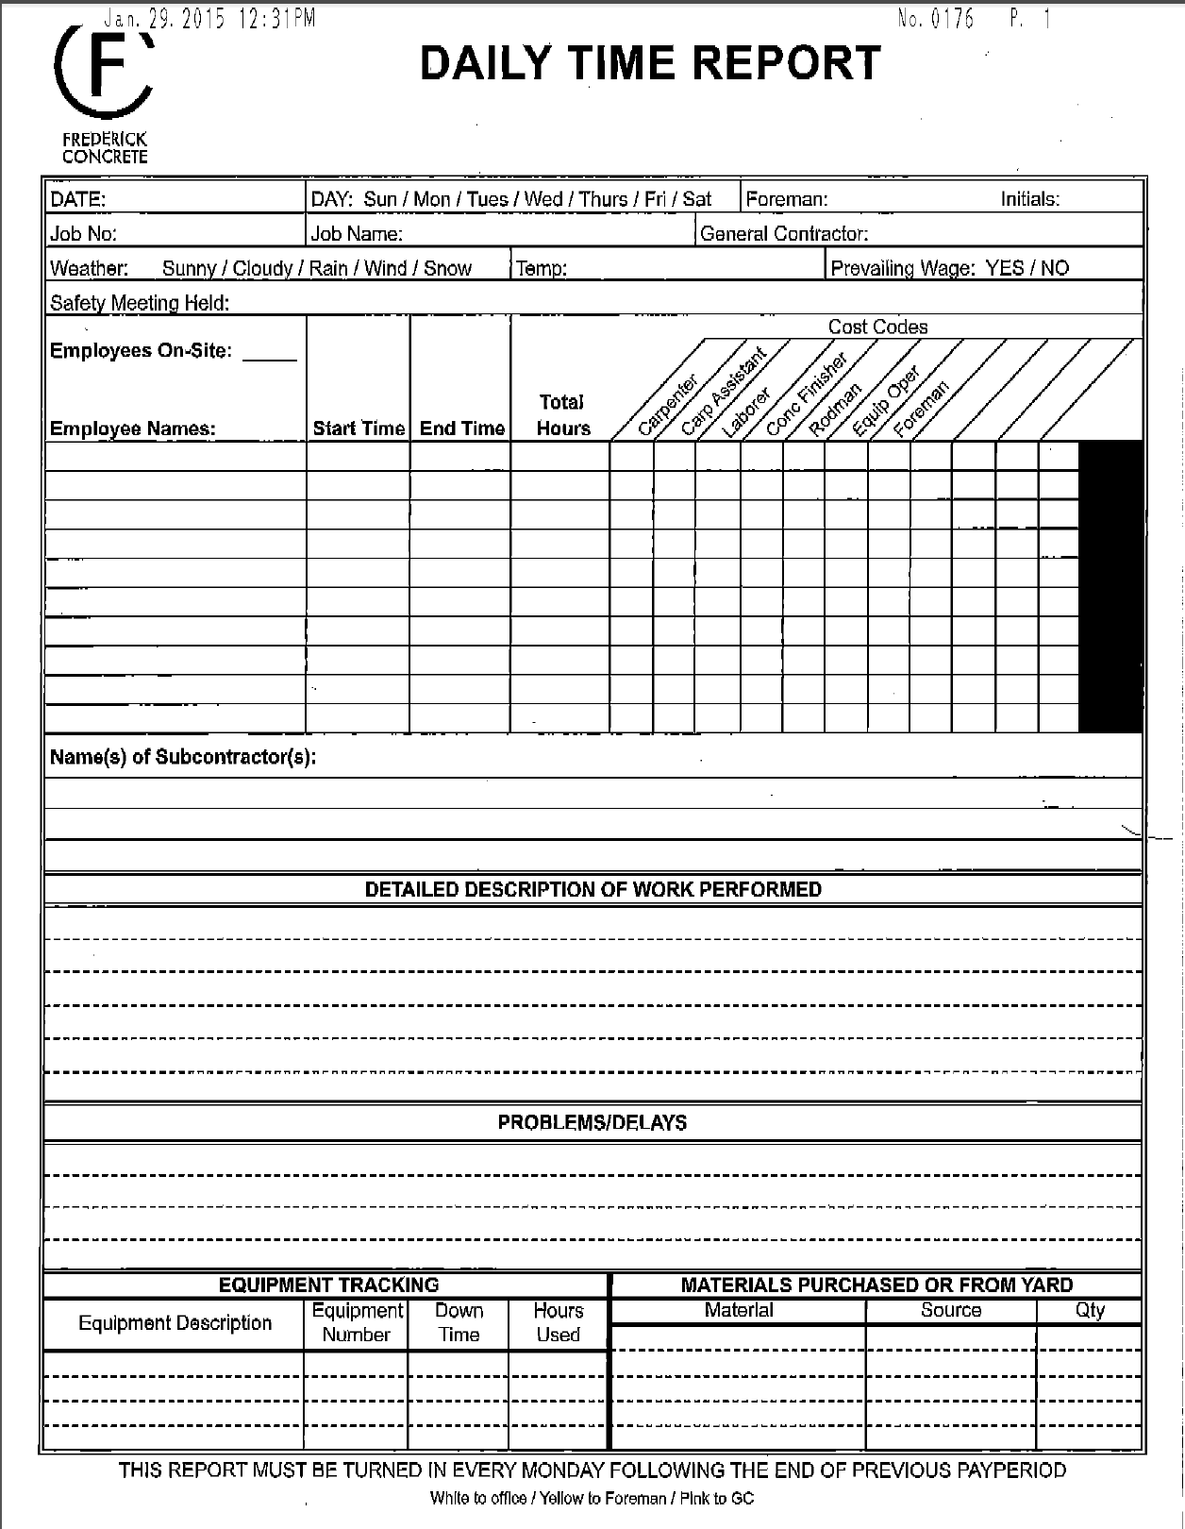
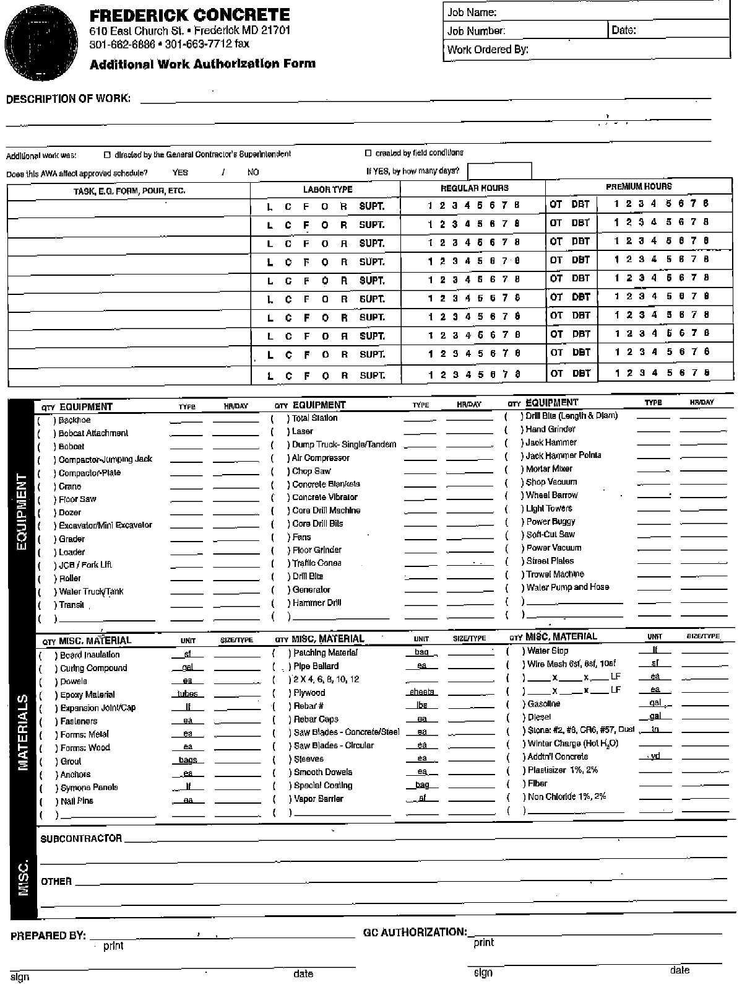
doForms uses all the functionality of today’s mobile devices to turn expensive, inefficient paper forms…

Slide 5
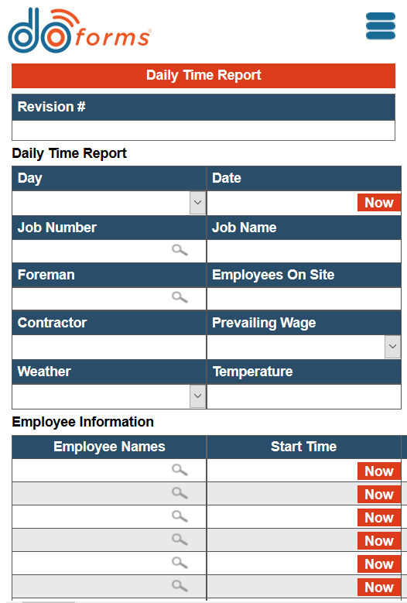
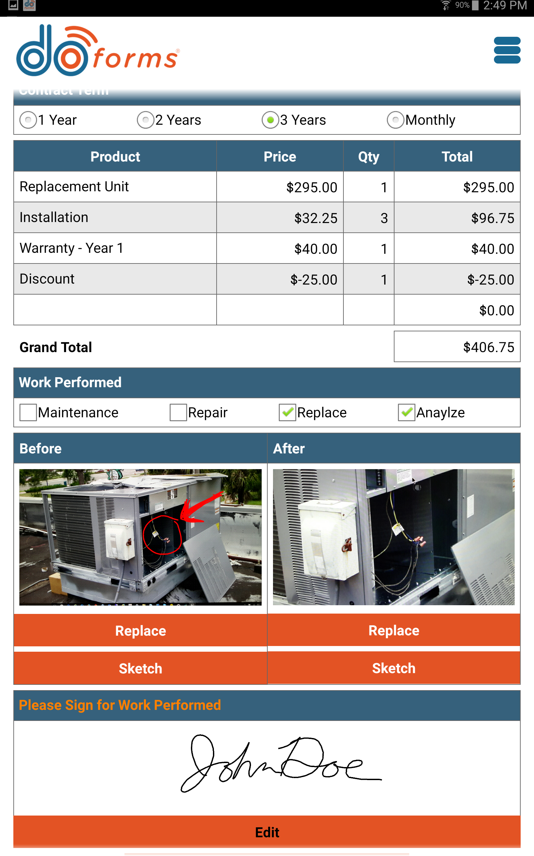

…into intelligent mobile forms…
Automatic day and date stamp
Instant,
on-page calculations
Lookup tables
Photo and sketch
Drop-down menu or pre-filled fields
Signature capture
GPS and mapping
Responsive form design optimizes to any device
PLUS swipe-less credit-card payment, barcode & NFC reading, dispatch and tracking, and more

Slide 6
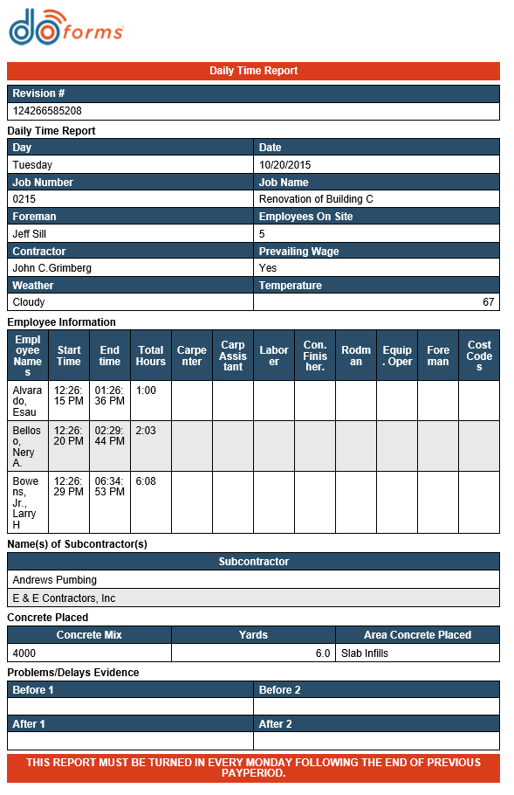
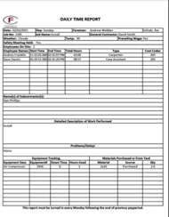

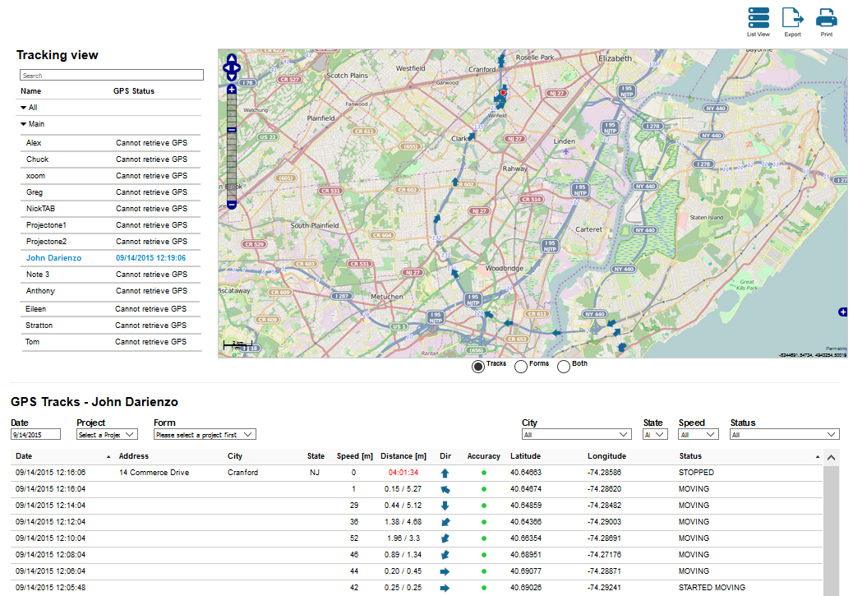



…and then into this automated data flow
Track workers and activities through the mobile device in real time
Send multiple PDFs from the form via email to anyone
Access forms data through our Web Dashboard; bring data directly into Excel spreadsheets
Bring data directly to and from your existing backend systems

Slide 7
doForms is very affordable
Core
Add-Ons
Professional
Dispatch & Tracking
Back-Office Integration
$9.95
per month/user
$8.33 if paid annually
^{add $}5.00
per month/user
$4.16 if paid annually
^{add $}5.00
per month/user
$4.16 if paid annually
Includes:
Includes:
Includes:
Mobile app for iPhone®, iPad® and Android™
Web app for desktops, laptops, and Windows devices
Web portal for building forms, managing users and data
Automated PDFs to multiple people in multiple formats from the same form
Unlimited forms per accounts
Export data from the portal, download using web services and Excel plug-in
Embed forms in emails, websites, or any medium that supports hyperlinks
• Real-time dispatching
Integration to ALL connectors.
$199 set-up fee per connector applies.
Database integration for: Access, MySQL, Oracle, Sage 50 / Sage 100, SQL Server, Sybase ASE
Application integration for: QuickBooks, Salesforce, Excel, SharePoint, Evernote, doForms Dispatch, Method CRM
Other integration for:
SMS (Clickatell), Text / CSV /
XML, ODBC, PDF Report,
Google Sheets
Unlimited downloads per account
Multi-account Enterprise options available
Enterprise pricing available starting at 100+ users
GPS tracking (requires WAN)
Form retrieval
Form forwarding
Unlimited dispatches per account
• Real-time status updates
Schedule assignments

Slide 8
You can try it risk-free – and doForms will build your first form free!
Give your rep a 1- to 2-page paper form you’re currently using…
doForms will create a branded custom 1-2 page form within 24 hours…
…put it in a free one-month trial account and demo it to you, then let you use it in the field…
…so you can see the power and ease of doForms for yourself.

Slide 9
Visit www.doforms.com for more information

