Slide 1
Healthcare Use Cases
Bringing the efficiency, data security, and cost savings of doForms to all aspects of healthcare
doForms, Inc.
14 Commerce Drive, Suite 100
Cranford, NJ 07016
908-505-9020
www.doforms.com
Contact: Laura Teller, SVP, Strategic Partnerships
lteller@doforms.com
908-505-9020 X 309; 609-613-3360 (M)

Slide 2
Healthcare Use Cases

Slide 3
Where can doForms be used in healthcare?
Selected (relevant) real-life examples
Services/ Maintenance
Gardeners/ Lawn Care
Pool Maintenance
Maids & Cleaning Services
Damage Remediation
Real Estate Management Companies
Janitorial Services
First Responders
Hospitals and Care Centers
Home Health Services
Incident data-gathering and documentation
Equipment/materials inventory and prep checklists
Pre/post vehicle inspections
Patient intake and health history data-gathering
Materials requisition
Facilities maintenance and inspection
PTO requests
Assignment dispatches
Employee time cards/reporting
Patient history and condition assessment data gathering
Inspection of premises/assessment of hazards
Field Services
Education
Surveying and research
In-field distribution of services, vaccines, etc.
Facilities management
Inspection of classrooms for compliance

Slide 4
How doForms fits in a HIPAA-compliant environment
doForms operates under a
Business Associate Agreement governing use of data

Slide 5
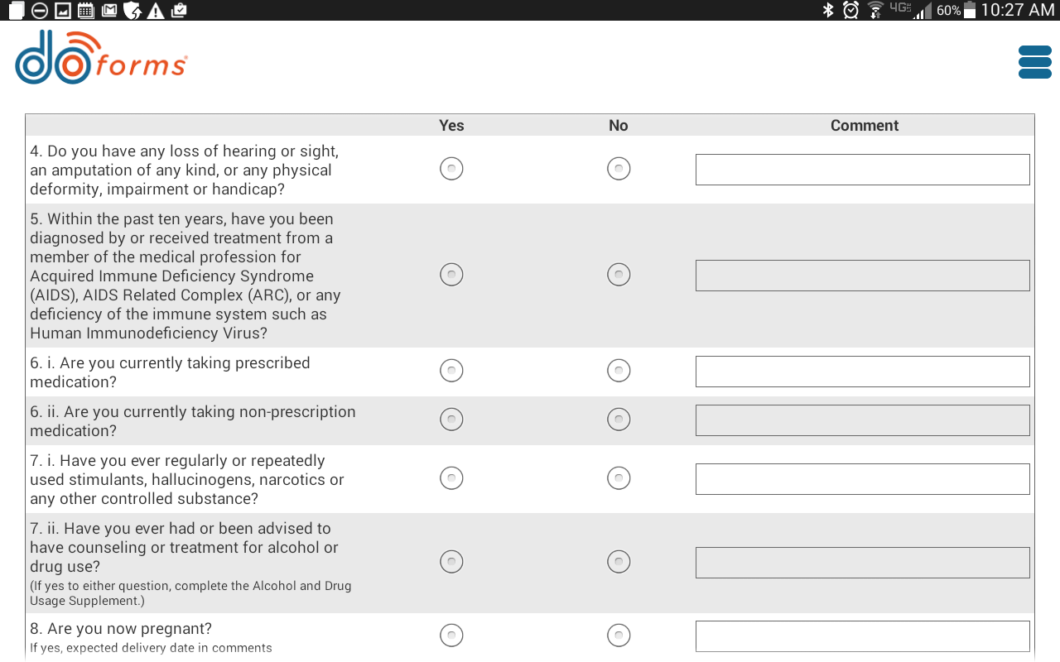
Use Case: in-home medical examinations
A company that performs in-home examinations of life insurance applicants for one of the largest U.S. life insurance companies uses doForms throughout its operations, from scheduling and dispatching all the way to capturing applicant data during the examination

Slide 6
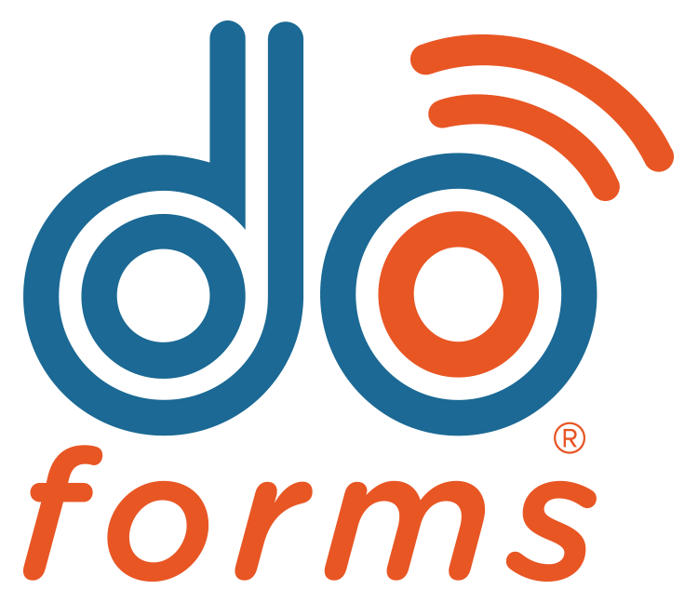


Use Case: in-home medical examinations (continued)
A complete, integrated workflow via doForms Sync & Save integration with Salesforce
7. Form information is sent back to customer’s web portal, PDF is sent to insurance company, and information is captured in Salesforce and also generates a bill to insurance company
2. doForms pulls assignments via its Sync & Save integration capability
Sync & Save
integration
5. doForms dispatches pre-filled form (address, directions) to nurse
6. Nurse completes examination using a doForm form on tablet
1. The company’s Salesforce records capture assignments from the insurance company
3. doForms alerts nurses of a potential job in their area via SMS.
4. If nurse accepts, doForms captures it and sends back to company

Slide 7

Using doForms to capture patient information and update daily charting
Making it easier to care for chronic conditions
Major coordinated care management program in upstate NY that provides services to clients with chronic conditions
Uses doForms for daily charting of mental status, vitals, and nurse’s notes
http://nfmmc.org/programs-services/health-home.php

Slide 8

Gathering patient assessment data
Assessing patients in their homes with doForms
Large regional health center providing home health services
doForms currently being evaluated for use for clinical assessment in the home, patient’s personal information, medical health history, medications, current health statuses, and needs that are filled out by clinicians

Slide 9

Creating new efficiencies in delivering home healthcare services
Using forms throughout the entire patient experience
One of the largest providers of health care services on the Gulf Coast, offering home healthcare, hospice care, and rehabilitation
Using doForms for patient discharge tracking, discharge follow-ups, chart documentation, risk assessments, surveys, equipment inventory, scheduling, and patient intake.

Slide 10
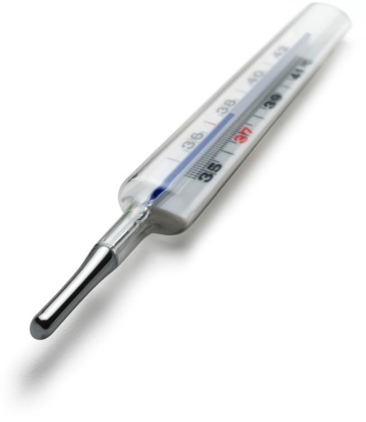
Streamlining patient check-in at a busy physician’s office
Improving the waiting room experience
Health care practice devoted to the care of women specializing in obstetrics, gynecology, infertility, and urogynecology
Using doForms to streamline patient intake and to obtain authorization information

Slide 11

Using doForms to stop global spread of AIDS
National Center for Biotechnology Information uses doForms for global field data collection
doForms is used as part of of an international, global effort to combat the HIV epidemic
Scientists are using doForms to collect data, including survey responses, barcodes for biological samples, and GPS coordinates for study sites
“This easy-to-use platform simplifies and facilitates the design and creation of data collection instruments, as well as the collection, management, and analysis of data… immensely improving the quality of our work, while saving us both time and money.”
-- Stephen Delgado, Senior Epidemiologist Consultant, HIV Prevention & Control, Central America Operations

Slide 12
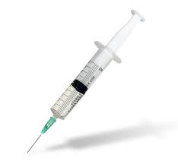
Using doForms to streamline delivery of urgent public healthcare
Supporting an initiative to protect 250,000 Haitians from cholera
doForms was used as part of major anti-cholera vaccination campaign, reading barcodes on individuals’ national ID cards in order to track inoculations
doForms delivered better process control and more complete, streamlined, and automated record-keeping

Slide 13
For more information, visit www.doForms.com or call 908-505-9020

