Slide 1
Not For Profit Case Studies

Slide 2
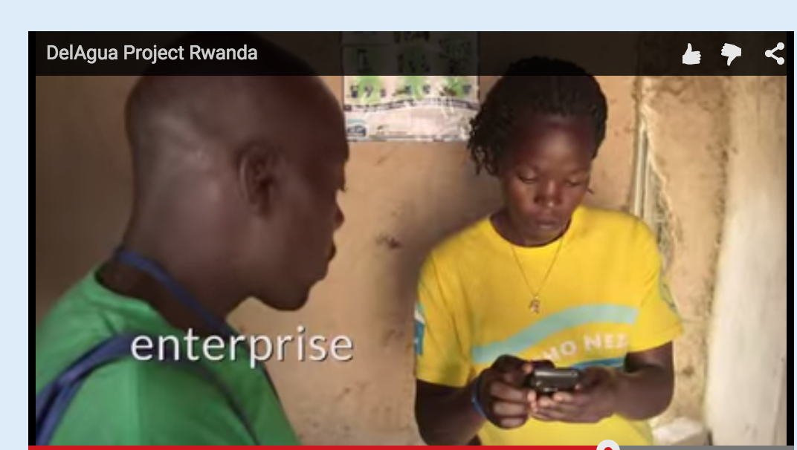
DelAgua is using us in Rwanda to distribute less polluting cookstoves and cleaner water
Use Case:
In-Country Program Management
A United Nations Clean Development Mechanism project
Del Agua distributing 600,000 clean-burning cookstoves and 600,000 advanced water filters in Rwanda touching 3 MM people and reducing
Using smartphones and doForms to:
Read bar codes of stoves/filters when distributed to households, and upload immediately to the cloud
Map the installation of units using doForms GPS capabilities

Slide 3
The National Center for Biotechnology Information uses doForms to collect field data globally
Use Case: Field Data Collection
Part of an international effort to combat the HIV epidemic – used globally
doForms used to collect data, including survey responses, barcodes for biological samples, and GPS coordinates for study sites
“This easy-to-use platform simplifies and facilitates the design and creation of data collection instruments, as well as the collection, management, and analysis of data… immensely improving the quality of our work, while saving us both time and money.”
Stephen Delgado, Senior Epidemiologist Consultant, HIV Prevention & Control, Central America Operations

Slide 4
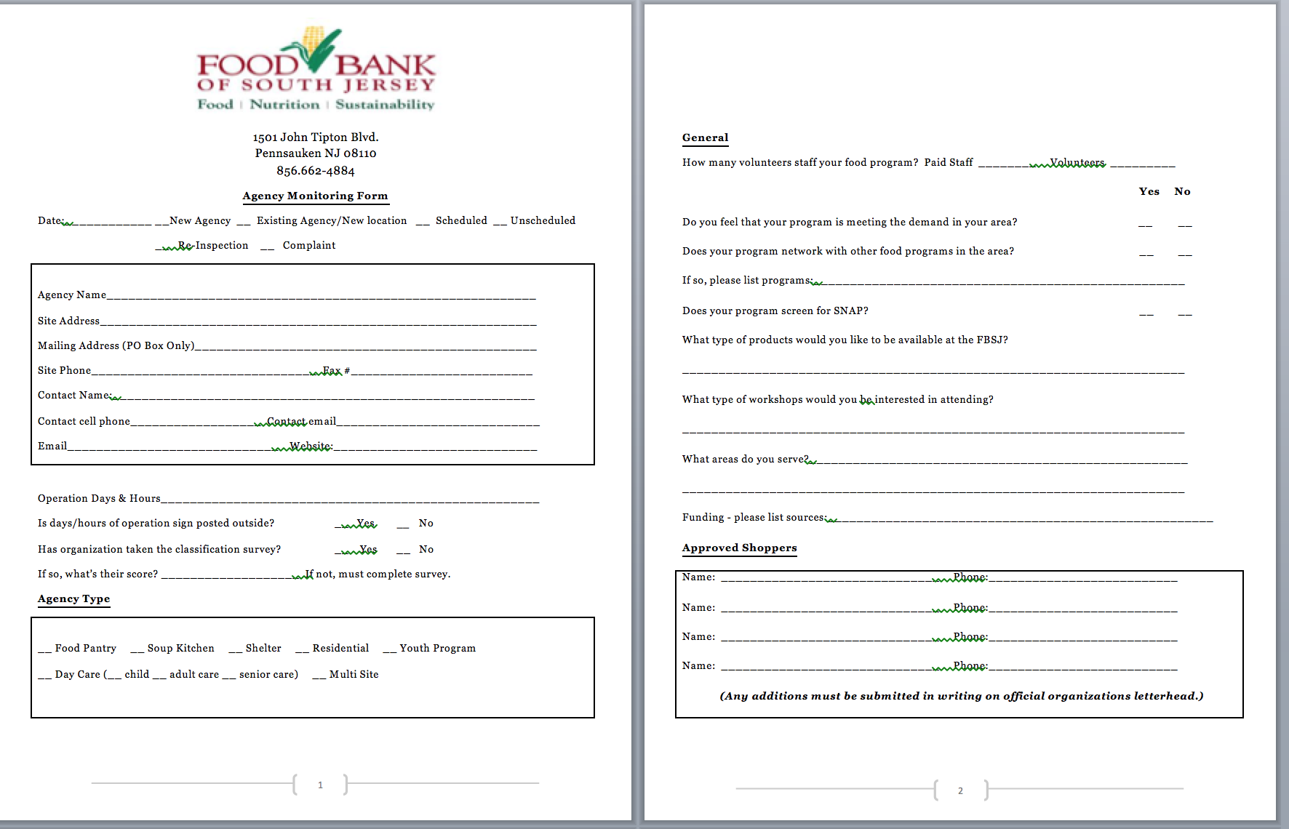
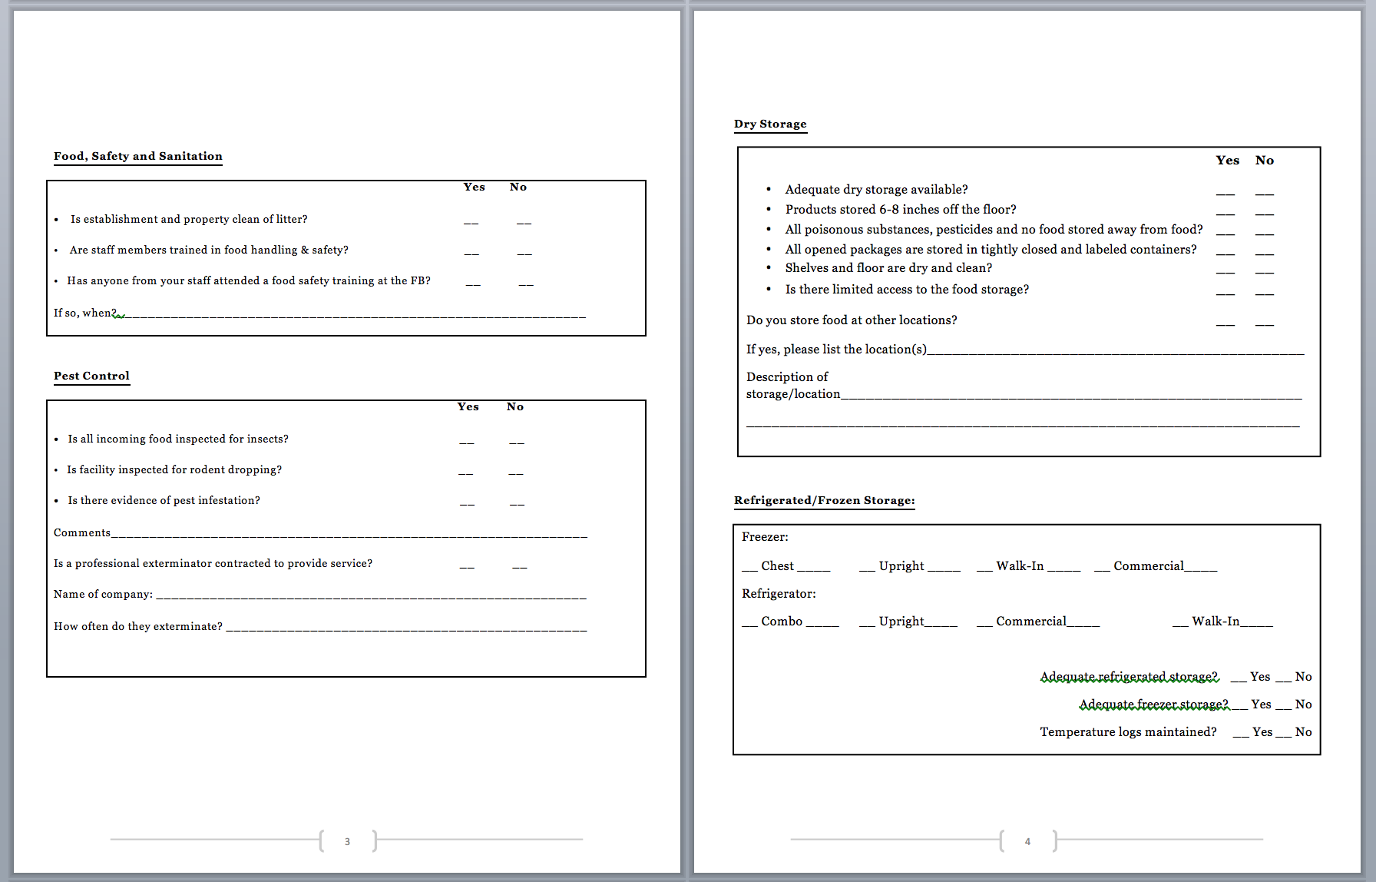
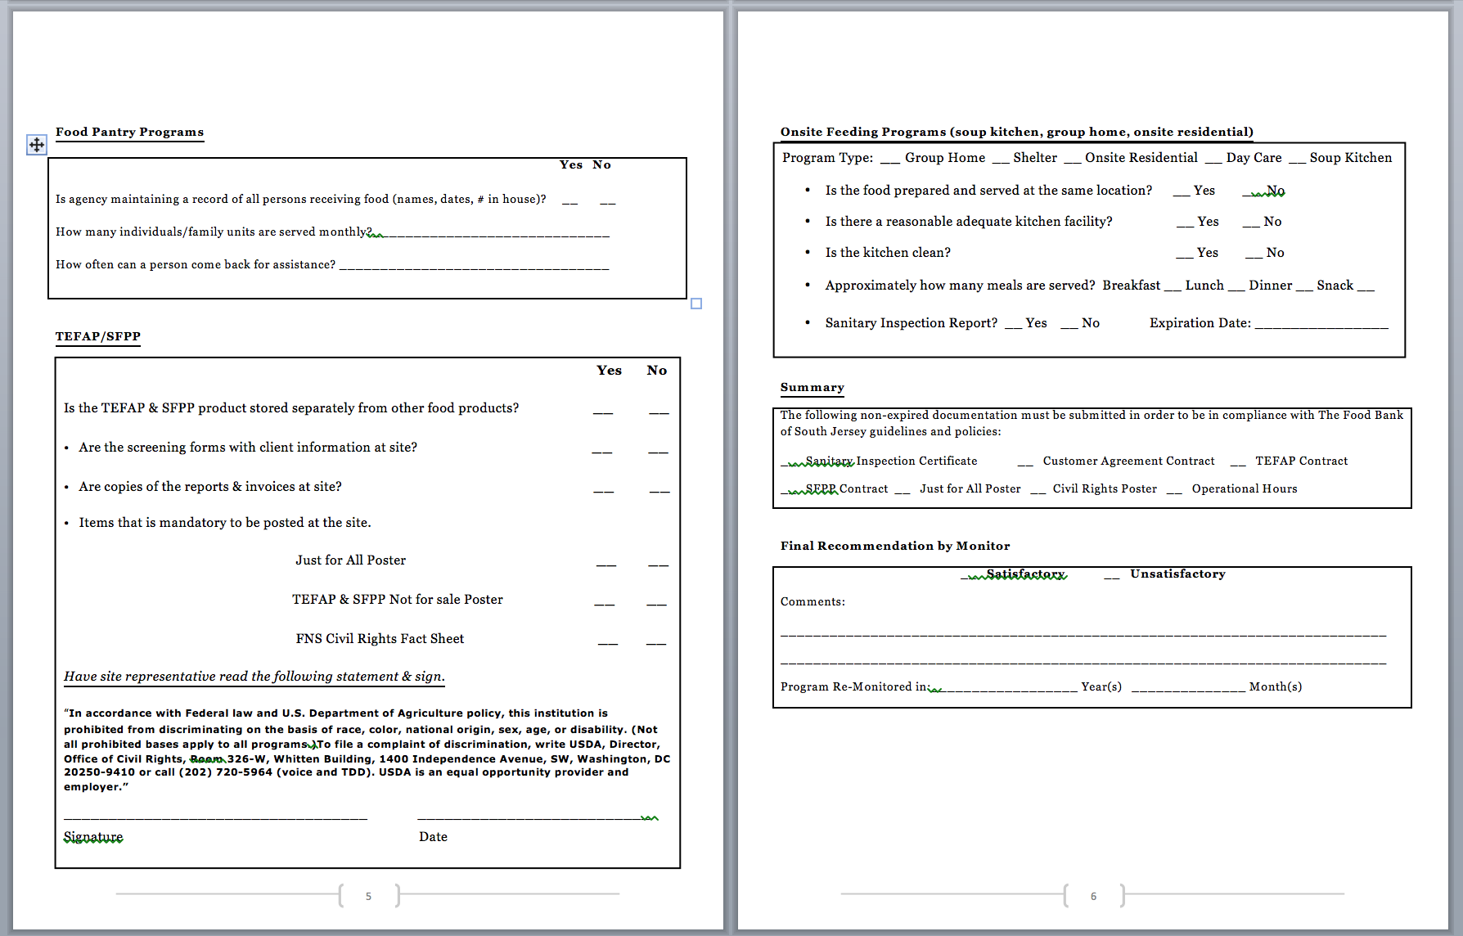
So we can eliminate this wasteful 6-page paper form…

Slide 5
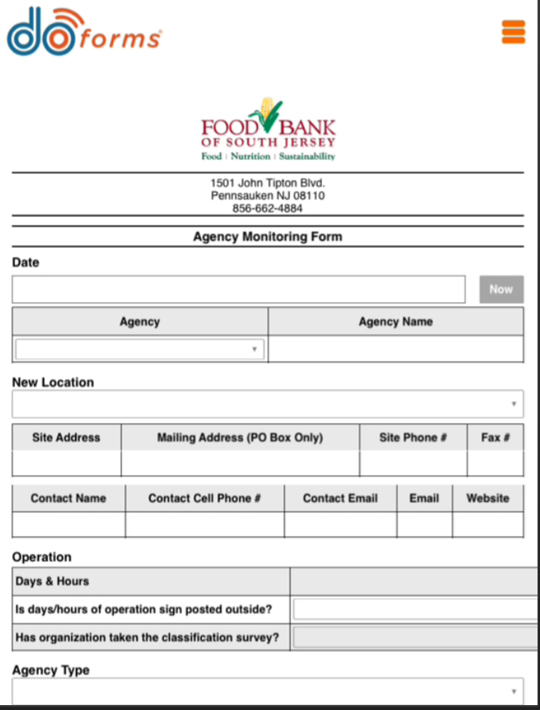
And turn it into an efficient mobile form!
Ask Breanna for this form

