Slide 1
doForms in the Government Vertical
Bringing efficiencies and cost savings to state, local, and federal goverments
June, 2015

Slide 2
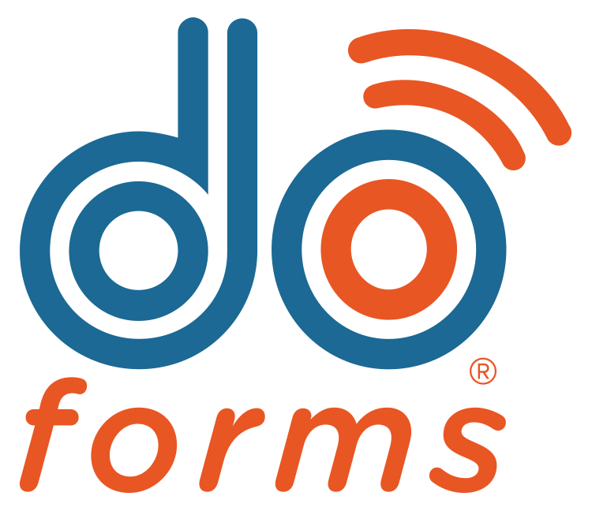
doForms Background
Founded 2010
Headquartered in Cranford, NJ (NY Metro Area) with offices in Georgia and Maine
SaaS, cloud-based technology model
Currently has over 13,000 paying customers globally – many coming through the Web, completely self-serviced
Horizontal solution – use cases in many different industries and functional areas
Highly secure – used in HIPPA-compliant solutions

Slide 3
Doforms and Government: Overview
200+ state, local, federal government, NGOs, and public utility use cases globally
Horizontal use cases throughout many different governmental functions
Facility, Utility, Public Works Field Inspection
Repairs and Maintenance Documentation and Management
Facilities Documentation
Data Gathering & In-Field Surveys
Work Force and Work Flow Management
Health Services
Police, Fire, Emergency Response
GSA registration pending (anticipated mid-July, 2015)

Slide 4
Use Cases

Slide 5
Canton, GA: Workflow and Jobs Management
Canton, GA uses doForms to create mobile applications that allow their departments to manage work orders throughout the city.
“By using doForms, we are able to create mobile applications that allow our departments to manage work orders throughout the city. It provides us with a more efficient way of collecting data and distributing our work force. By using doForms, we are able to save time and money.”
--Camille Wehs, Director of IT/GIS, City of Canton, GA

Slide 6
Large Public School System: Maintenance and Cleaning Services
One of the largest public schools systems in the U.S. uses doForms to track and QA janitorial services in its schools.
doForms allows cleaning crews and inspectors to easily monitor equipment and cleaning materials usage, and document, prioritize, and schedule necessary maintenance and repairs.

Slide 7
Military Base Management & Inspection: Water Supply Maintenance and Environmental Compliance
A subcontractor to the U.S. military uses doForms to inspect utilities and ensure water use and environmental compliance for Ft. Benning, GA.
The subcontractor reports that it has cut the time it takes to complete and document inspections by over 75%: “What used to take us 6 days now takes 1.”

Slide 8
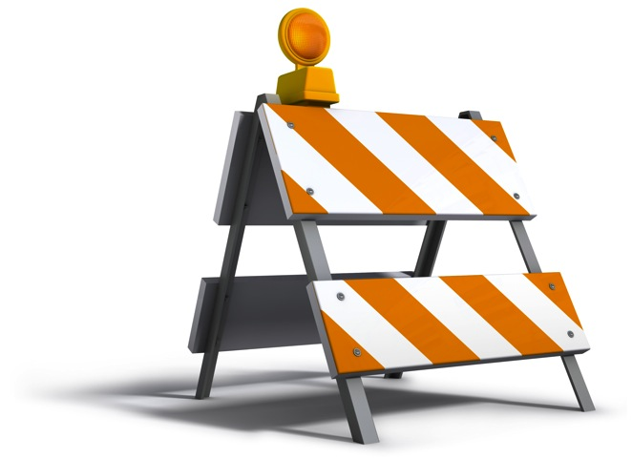
Utilities Maintenance: Gas Transmission Facilities Inspection
One of the largest West Coast utilities, Pacific Gas & Electric, employs doForms in its gas transmission operations for maintenance and inspection services.
“We can save money and training by having people who work on the collected data for analysis rather than doing heavy lifting data work in the field.”

Slide 9
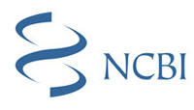
National Center for Biotechnology Information: Global Field Data Collection
doForms is used as part of of an international, global effort to combat the HIV epidemic. Scientists are using doForms to collect data, including survey responses, barcodes for biological samples, and GPS coordinates for study sites
“This easy-to-use platform simplifies and facilitates the design and creation of data collection instruments, as well as the collection, management, and analysis of data… immensely improving the quality of our work, while saving us both time and money.”-- Stephen Delgado, Senior Epidemiologist Consultant, HIV Prevention & Control, Central America Operations

Slide 10
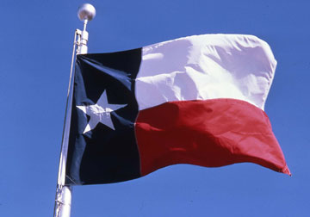
Case Study: Improving Excavation Management, City of Brenham, Texas
Case 1: Streamlining dispatches for digging. “In Texas (and many other states), any digging to a depth greater than 16 inches requires a call to the Texas 811 Call Center, which then dispatches a "ticket" to the utility company. The utility company then has 48 hours to mark the utility lines in the area of the excavation site. Disruption of service (gas, electric, water, telephone, etc.) and possible injury to the excavator is avoided by knowing where the utility lines are located. Before doForms, our line locators were contacted by our office whenever a 811 ticket was received and the ticket was placed in an out box for pickup. So the locator would have to drive in repeatedly from the field throughout the day to pickup new tickets and drop off completed tickets. With doForms Dispatch, the locators can stay out in the field and receive and send tickets, a much more efficient process.”
Case 2: Documenting line “hits” to end disputes. “Each locate requires photos of the locator's line markings, which come into play whenever an excavator hits a utility line. All gas lines that have been hit have to be reported to the Texas Railroad Commission by the utility operator and the excavator. Each case is reviewed and fines assessed if any violations to excavation rules are discovered. Whenever there are disputes between parties or personal injuries involved, the photo evidence before and after pipe damage is critical. Before doForms, the locators took pictures with a digital camera and then transferred the pictures to a computer. They then had to organize and label the photos to the associated ticket. This was a very time-consuming and sometimes confusing process, particularly if multiple locations were assessed in a single day. With doForms, integration of the photos into the Line Locate form made this part much easier.”
Case 3: Improving compliance. With the Line Locate doForm, the locator has to answer a series of questions regarding the utility markings which follows the TX Railroad Commission rules and helps us from a compliance aspect. At the end of each month, we export the line locate data into an Excel worksheet and prepare a summary report for management. So, with this one process, you could capture a lot of features available with the doForm app.”

