Slide 1
Use Cases in Professional Services/Banking & Financial

Slide 2
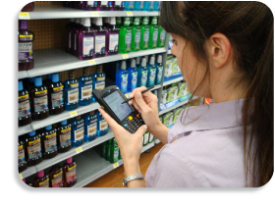
Consulting Firms: Enabling Field Research
Consulting Firm in South American
Uses doForms for surveying customers and retail sites in the field
Rapid build of data capture forms and gathering of data from the field can be accomplished without IT involvement
Forms are developed for Spanish, English, Portuguese
Ongoing, automatic upload of data and integrated flow into Excel spreadsheets has dramatically reduced the time it takes to gather and interpret data from the field – while also reducing manual data input

Slide 3
Marketing Research Firms: Real-time Surveying
NASCAR Fan Research
doForms are being used by NASCAR at three race sites to survey fans during races as well as to inspect sites for maintenance and crowding issues
Researchers deployed with tablets into the stands during races
Reduced time to complete forms allows researchers to talk to more people per race
Results can be compiled much more quickly, without manual data entry

Slide 4
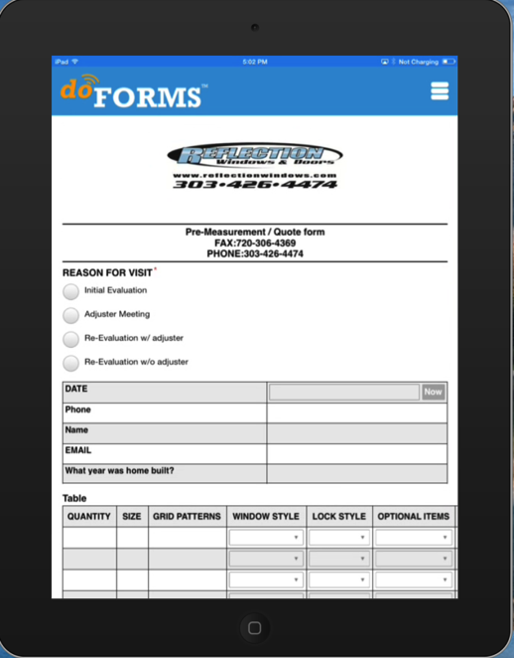
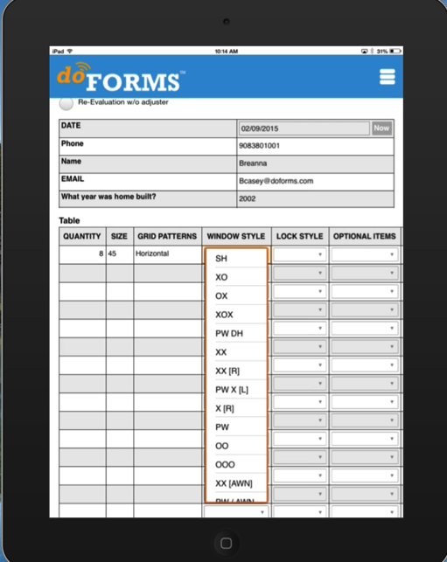
Insurance: Damage Appraisal and Claims Adjustment
Documentation for Property Damage
Situation:
Large window company often given assignments by insurance companies to appraise damage, estimate repair costs and propose approaches/materials for fixing broken windows
Insurance companies require detailed back-up and documentation, including location, photos, detailed explanation of damage, equipment and window specifications, cost estimates, owner sign-off, and more
doForms allows estimators and crews to easily provide this documentation in a single form
Similar form can be used by insurance appraisers and claims adjusters for property, auto, theft

Slide 5
Banking: Facilities Management Ensuring uniform quality & standards in retail banking environments
Simpler, More Detailed Visibility into Retail Sites
Large international QSR franchisor (but retail banking faces similar challenges in site management)
Critical for branding to ensure consistency, quality, and cleanliness of retail operations
Frequent inspections by field inspectors are required
doForms now used to capture all the information once requiring 15+ page form
Quality of information better, controversies reduced – reports now integrate photos, time stamps, inspector comments, operator sign-offs

